Slide 1
Graph learning lab
Exercise II- Graph Convolutional Networks

Slide 2
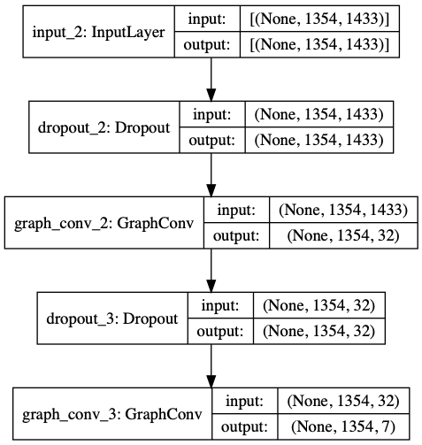
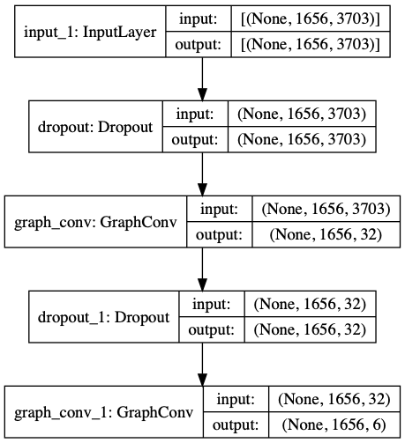

Task Description:
1- Node Classification: (Abheek, Supreet, Alexandra)
Using the Keras framework to implement a 2-layer GCN following the layer propagation rule: $f\left(H^{\left(l\right)}, A\right)=σ (D^{−\frac{1}{2}}A^{\sim }D^{−\frac{1}{2}} H^{\left(l\right)}W^{\left(l\right)})$ ¹ to classify the nodes of a graph into their respective node labels.
CORA:
CITESEER:

Slide 3
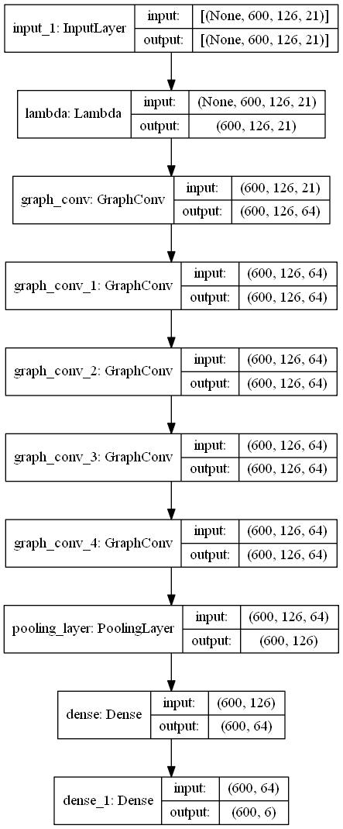
2- Evaluation of Node Classification: (Abheek)
Evaluating the performance of our GCN model on the datasets CORA and CITESEER. The mean training and testing accuracies were reported after repeating the experiment 10 times.
3- Graph Classification: (Abheek,Supreet)
Implemented a deep GCN model to perform the Graph Classification task. (Faced problem in pooling layer and dense)

Slide 4
4- Evaluation of Graph Classification: (Abheek)
Evaluated the performance of our GCN for Graph Classification on the graphs of NCI1 and ENZYMES datasets. (No results due to problem in 3rd exercise)
5- README and PowerPoint: (Alexandra)

Slide 5
Results:
CORA | CITESEER
0.88±0.004 | 0.87±0.002
0.52±0.007 | 0.56±0.006
Training
Testing
~We couldn’t achieve the minimum accuracy for the datasets.
~Training sets performed well but testing sets not.

